Slide 1
Building a rocket

Slide 2
What is a rocket?
A rocket is a vehicle that uses jet propulsion to accelerate.
The propellant is carried within the vehicle.
Rockets can fly in the vacuum of space. They are used for satellites, human spaceflights, and space exploration.
Jet propulsion → moving in one direction by ejecting a fluid in the opposite direction

Slide 3
What do we need?
First of all we need a propellant.
To make our propellant we are using an easy chemical reaction that we can obtain by mixing vinegar with baking soda.
Vinegar + baking soda → CO2.

Slide 4
Vinegar and baking soda
In chemestry, when you mix different elements, there is usually a reaction. Some reactions can be small, some can be big.
Vinegar is an acid, like lemon. Baking soda is a base, like soap.
When you put vinegar and baking soda together, a lot of things happen. One of those is producing CO2, which we’ll need as propellant for our rocket.

Slide 5
What does CO2 looks like?
Rocket scientists have to be 100% sure about the propellant they are using.
How do we know if we are really making CO2?
CO2 is a gas. How does a gas look like? How can we see a gas? Think about it!

Slide 6
How to see gas
Humans breathe oxygen, right?
Oxygen is a gas. How can you see oxygen? Think about when you go to the seaside, or the swimming pool.
You can see a gas when you put it in a liquid! What does it look like? Bubbles.

Slide 7
Experiment n.1: «Making our propellant»
Let’s try to make some CO2!
Take some vinegar and some baking soda. Mix them together.
What happens? How do we know if we actually made some CO2?

Slide 8
Results
When we mix baking soda and vinegar we see…
BUBBLES!
Those bubbles are CO2. It is usually found in many drinks (coca cola, fanta, pepsi, etc.).

Slide 9
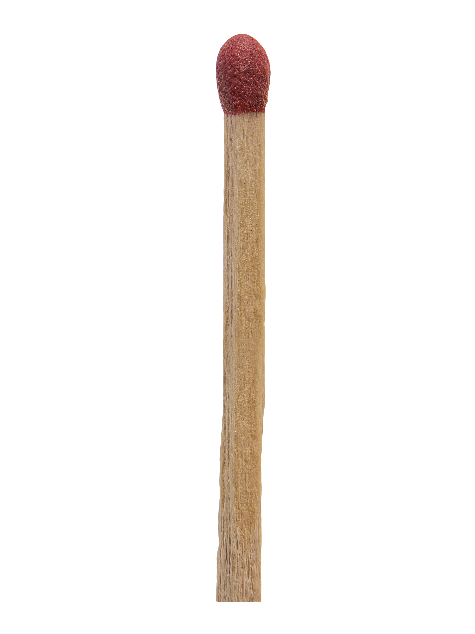
Experiment n.2: «The match»
How do we know the bubbles are CO2 and not oxygen?
We can prove it using a match! To make fire, we need oxygen. If there’s no oxygen, there’s no fire.
Repeat experiment 1. Light a match and see what happens.

Slide 10
And now?
Ok, now we can make our propellant. But how do we use it? What can we do with a gas?
Time for another experiment!

Slide 11
Experiment n.3: «Understanding our propellant»
For this experiments we need: vinegar, baking soda, a balloon, 2 test tubes.
Put some vinegar in the first test tube. Put some baking soda in the second test tube. Put a balloon on the baking soda tube, and put the baking soda inside the balloon. Take off the balloon full of baking soda, and put it on the vinegar test tube. Empty the baking soda in the vinegar test tube. What happens?

Slide 12
Results
The CO2 inflated the balloon. Now we have a balloon full of CO2. What happens if we add more CO2 to the balloon?
What happens if we put the CO2 in a different container?
What happens if we release the CO2?

Slide 13
How to use our propellant
This is how we are using our propellant.
We put a lot of CO2, that we can create by mixing baking soda and vinegar, inside a rocket. The CO2 is going to create a lot of pressure. When the pressure is enough, our rocket will finally lift off.

Slide 14
How do we make a rocket?
First of all, we need a container for the CO2.
Can you think of something that looks like a rocket that we could use as a container?

Slide 15
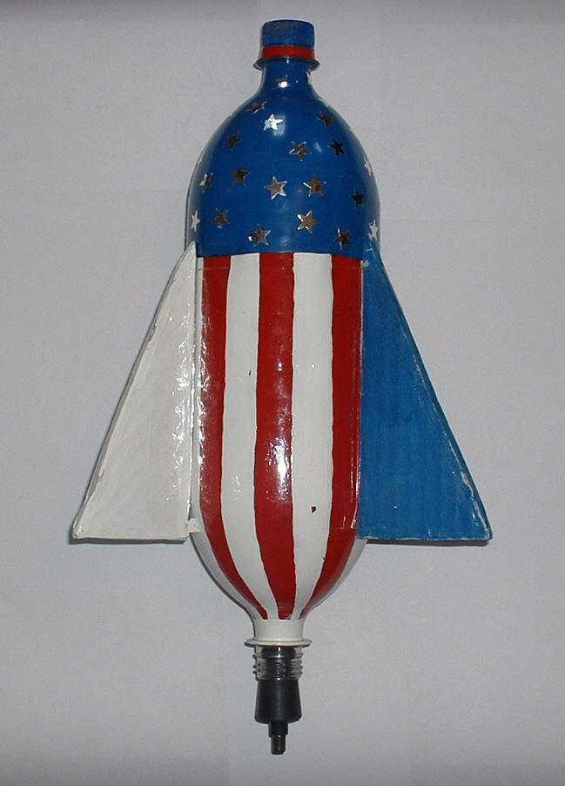
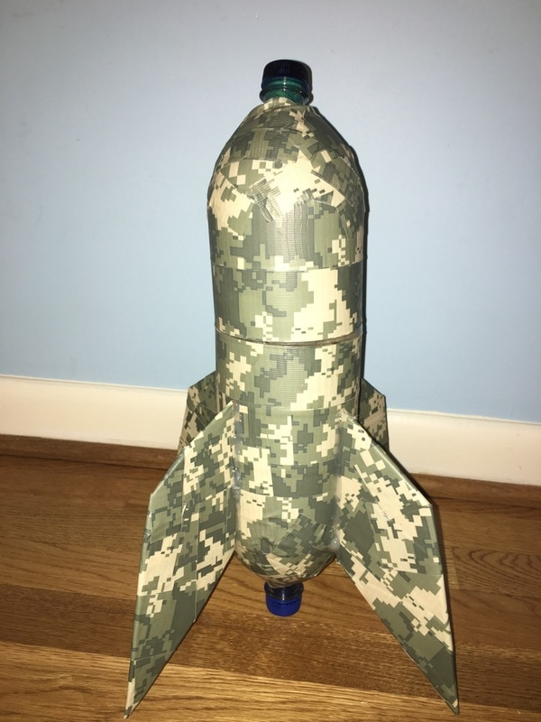
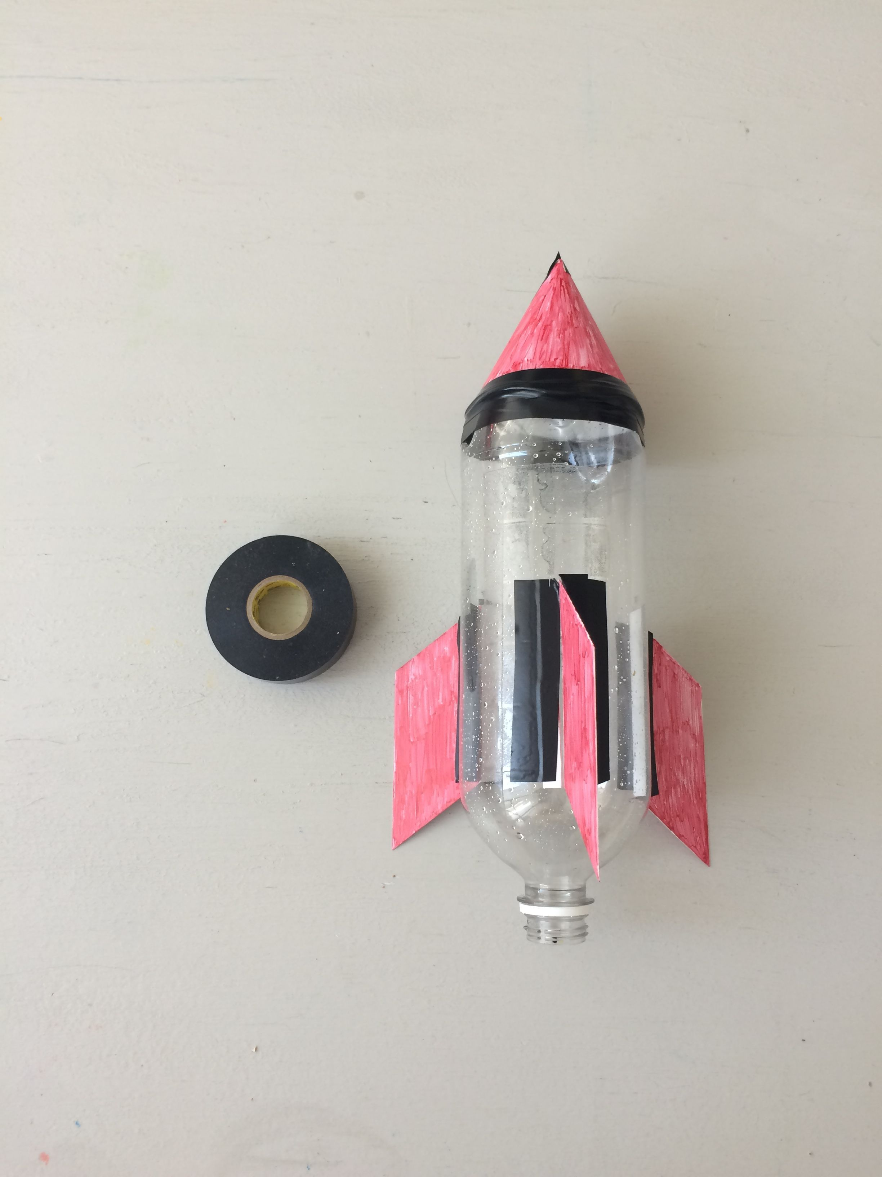
Water bottles can be fantastic rockets!

Slide 16
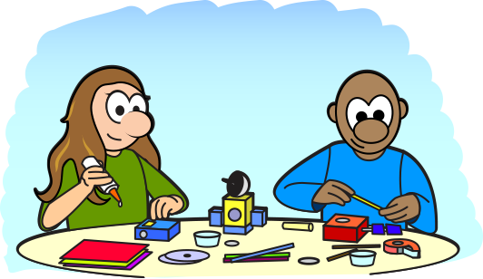
Building our rockets
Material: empty plastic bottle; tape; sticks, cork, scissors, vinegar, baking soda.
Step 1: Take the empty plastic bottle and tape the wooden sticks. They will be our launching pad.
Step 2: Check if the cork fits the water bottle. You can use duct tape to make it fit better.

Slide 17
Building our rockets
Step 3: Decorate your rocket
Step 4: Make a funnel. We are going to use it to insert the baking soda.
Step 5: We are ready to launch!

Slide 18
Safety regulations
To launch the rocket we have to go to an open space.
Only the teacher can add the ingredients.
Stay back and watch

Slide 19
Sources
https://www.youtube.com/watch?v=Jier8i9c8l8&ab_channel=AdventureDiegooz
https://www.youtube.com/watch?v=jjU1IAgRcQg&ab_channel=STEMLittleExplorers

